Slide 1
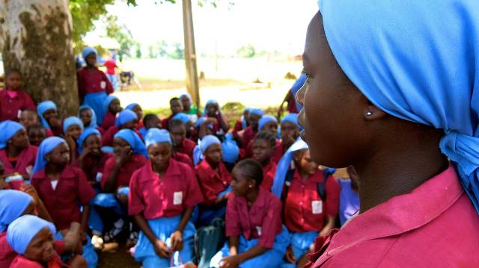
Assembly (key stage 4)
Notes:
Assembly (key stage 4) – Send ALL My Friends to School 2015
Who can say why 2015 is a milestone year?
Photo: Jon Hughes/ActionAid

Slide 2
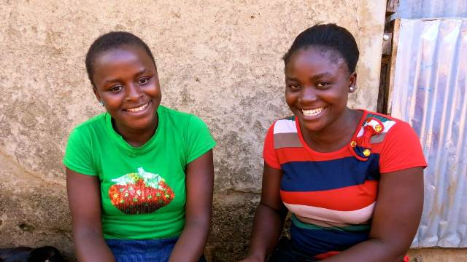
Notes:
Why is 2015 a milestone year?
2015 is the year that Jemimah Belus (on the right) went back to school.
She is twenty four years old and dropped out of school nine years ago when she became pregnant.
Simon Abigail (on the left) persuaded Jemimah to return to school.
Simon Abigail is one of the Girls’ Club leaders in Manchok, an area of central Nigeria, West Africa. She told us that even though girls’ safety is an issue here, the biggest problem is still poverty: “I normally feel on top of the world; I normally feel happy to see I convince a girl to come to school. My proudest moment is that I advised a girl, named Jemimah. I visited her and advised her that she should try her best to come to school because she needs to be educated.”
Photo: Jon Hughes/ActionAid

Slide 3
Notes:
Why is 2015 a milestone year?
2015 is also the year in which Jemimah is also helping her daughter Jessica to read and write.
Jemimah is proud to be a part of the Girls Club. She says, these girls are confident and proud of who they are. They want to go on and fulfil their potential; not only for themselves but for their families, communities and country.
Jemimah wants to see a renewed commitment from world leaders to get ALL children into school in 2015.
Photo: Jon Hughes/ActionAid

Slide 4
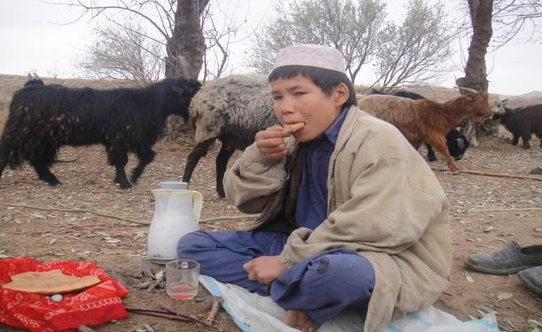
Notes:
Why is 2015 a milestone year?
2015 is the year that could change the future for millions of people like Jemimah, Jessica and Simon Abigail from Nigeria, as well as Roz Mohammed from Afghanistan.
This photo shows Roz eating his lunch. Instead of going to school, Roz works as a goat shepherd in the deserts of the north of the country. He guides and takes care of these animals, and wants to put his shepherding skills into one day being a teacher.
It is important to know some of the facts behind stories like Roz’s. Such as, how many other children in the world are missing an education (you could plant three people in the audience to call out or hold up these options):
37 million
10 million
or 58 million?
Answer: 58 million children are missing out on school.
For more ideas, see activities at: www.sendmyfriend.org/resources. For ‘Teacher to Teacher CPD’ ideas go to: at www.sendmyfriend.org/cpd.
Photo: ActionAid

Slide 5
Notes:
Why is 2015 a milestone year?
2015 is also a milestone year for Emily Pemberton from Cardiff.
Here she is speaking with politician Ed Miliband at the launch of the Global Campaign for Education in January 2015. She is presenting him with a global letter about the urgent action world leaders need to take in 2015 to ensure the right decisions are made for people and planet.
Emily reminded everyone that in the year 2000 over 180 countries signed up to a set of commitments for a better world, and to tackle issues such as hunger and poverty. These were called the Millennium Development Goals included a goal of education for ALL.
World leaders promised all children would be given a primary education. But, says Emily, there are still 58 million children missing out on school and this year we are demanding they take urgent action to finish what they started.
It is now 2015 and time for world leaders to face the fact that they have failed to meet their promises.
Emily adds: “It was good to see that politicians are actually listening to the voices of young people, and aren’t just dismissing our ideas and visions for the future.”
Photo: Send My Friend to School 2015

Slide 6
Notes:
Why is 2015 a milestone year?
Here’s Emily with her friend George Watts. Emily and George are both Young Ambassadors for the Send My Friend to School campaign in 2015.
The pair, from Ysgol Gyfun Plasmawr in Cardiff, are determined to work with schools across the UK in holding world leaders accountable.
They want to remind us that Send My Friend to School has had a lot of achievements. Since it began, 50 million children have gone to school and millions more have spoken up for every child’s right to education. In 2008 Send My Friend to School set an amazing world record when 8.8 million people took part in the World’s Biggest Lesson. In 2014, following months of pressure from education campaigners, world leaders from both donor and developing countries pledged nearly £17 billion for global education.
But, say Emily and George, with 58 million children still missing an education, now is the time to put pressure on world leaders like never before.
Photo: Send My Friend to School 2015

Slide 7
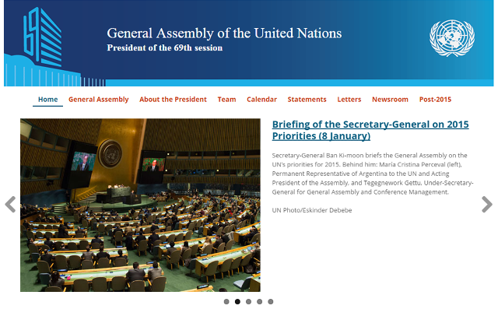
Notes:
Why is 2015 a milestone year?
During August and September 2015 , world leaders will gather at the United Nations General Assembly (UNGA) in New York.
They will decide how to tackle global poverty over the next 15 years. They aim to agree a new set of Sustainable Development Goals (SDGs) for 2030.
We can influence decisions if we speak up now. If leaders make the right decisions all children should receive a good quality education.
Screenshot: www.un.org

Slide 8
Notes:
The time to act is NOW!
The time to act is NOW! Students from Seven Kings High School in Ilford have already started. So, let’s join them and children from across the UK taking part in our 2015 campaign.
Begin with imagining you are a world leader. You are responsible for making crucial decisions at the UNGA in September.
How would you get every child into school?
Photo: Send My Friend to School 2015

Slide 9
Notes:
The time to act is NOW!
To get our voices heard, we can make 3D ‘world leaders’.
Using the template in the schools pack, follow the instructions and write a message saying what you would do if you were in charge.
These 3D ‘world leaders’ will be an urgent reminder of what world leaders need to do in 2015 to get all children into school.
Photo: Send My Friend to School 2015

Slide 10
Notes:
The time to act is NOW!
Gather all your ‘world leaders’ together in an imaginary United Nations (UN) meeting at your school.
The next step is to share your messages with people in power and make a real difference.
You could invite your Member of Parliament (MP) and local media into school, and take part in an online virtual ‘UN meeting’, where ‘world leaders’ from across the UK will speak up for education.
For ideas on how to run a UN meeting at your school, visit: www.sendmyfriend.org/resources. For ‘Teacher to Teacher CPD’ ideas go to: at www.sendmyfriend.org/cpd.
Photo: Send My Friend to School 2015

Slide 11
Notes:
If I were a world leader …
What would you do if you were a world leader?
Before we speak up and make new promises, let’s get to grips with a few more facts.
Which groups of children are least likely to go to school (you could plant five people in the audience to call out or hold up these options):
girls
boys
children living with disability
children living with pets
children living with conflict?
Answer: Girls, children living with disability, and children living with conflict are most at risk of missing out.
If the current pace continues it will be 2086 before all children complete primary school, and almost 100 years before they finish the first years of secondary.
For more ideas, see activities at: www.sendmyfriend.org/resources. For ‘Teacher to Teacher CPD’ ideas go to: at www.sendmyfriend.org/cpd.
Photo: Emdadul Islam Bitu/ActionAid

Slide 12
Notes:
If I were a world leader …
Meet thirteen-year-old Kona Akter from Bangladesh. Kona goes to school four to five days at the end of every month.
For the rest of the time she works at home, doing jobs like harvesting chilies and making food. She borrows school notes from her friends and studies in the early morning and late evening. Kona wants to be a teacher and hopes to go to school more in 2015.
Out of the 781 million illiterate people in the world, how many are female (plant four people in the audience to call out or hold up these options):
half
two thirds
all
one third?
Answer: Two thirds of the world’s illiterate people are female.
More flexible schools are needed so that girls can continue to work and go to school for a few hours every day. Then, families are not put in a position of having to choose between education and earning enough money to survive.
What would you do to make sure more girls get a chance to go to school? If I were world leader …
For more ideas, see activities at: www.sendmyfriend.org/resources. For ‘Teacher to Teacher CPD’ ideas go to: at www.sendmyfriend.org/cpd.
Photo: Emdadul Islam Bitu/ActionAid

Slide 13
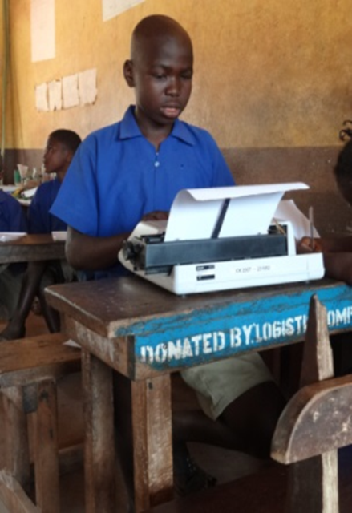
Notes:
If I were a world leader …
Meet Sorie Kanu. He is fourteen-years-old, has low vision, and attends a school near to his home in northern Sierra Leone.
However, this was not always his story. When Sorie was younger, local schools would not accept children with disabilities. So Sorie and his family did all they could to persuade schools to give him a chance.
How many out of school children live with a disability (plant four people in the audience to call out or hold up these options):
1 in 5
1 in 3
1 in 6
1 in 7?
Answer: 1 in 3 children out of school live with a disability.
What would you do to make sure more children living with disability get a chance to go to school? If I were world leader …
For more ideas, see activities at: www.sendmyfriend.org/resources. For ‘Teacher to Teacher CPD’ ideas go to: at www.sendmyfriend.org/cpd.
Photo: Sightsavers

Slide 14
Notes:
If I were a world leader …
Meet six-year-old Sakaina from Bamyan in Afghanistan. Many children like Sakaina are among the civilian casualties of war. Boys and girls may be recruited by armed groups, separated from their families and forcibly displaced, and they can get injured and even killed. Parents' livelihoods are destroyed and basic services disrupted, increasing the number of children suffering from malnutrition, and dying from preventable or curable diseases increases.
Of the 58 million children missing out on primary school, how many live in countries affected by conflict (plant four people in the audience to call out or hold up these options):
over half
two thirds
all
under one third?
Answer: Over half of children missing out on primary school live in countries affected by conflict.
What would you do to make sure children living with conflict get a chance to go to school? If I were world leader …
For more ideas, see activities at: www.sendmyfriend.org/resources. For ‘Teacher to Teacher CPD’ ideas go to: at www.sendmyfriend.org/cpd.
Photo: ActionAid

Slide 15
Notes:
Tips from inspiring role models …
Now that we’re more informed, let’s meet some inspiring role models who can give us some tips on how to take action.
Meet Precious Luka. Precious can teach us how to be a leader and persuade others to get involved with Send My Friend To School. Precious is fifteen years old and runs a Girls Club in Manchok, central Nigeria.
Do you remember Simon Abigail from the introduction and how she persuaded Jemimah to go back to school? These young women are very courageous. In the nearby town of Chibook in April 2014, over 200 girls were abducted from their school. These girls were kidnapped by Boko Haram, an Islamic extremist group whose name means ‘Western education is forbidden’.
Here, Precious is encouraging everyone to be confident and to continue coming to school so they can learn skills for life, like leadership, team working, and using their voice to help others: “I usually advise the girls on how to come to school, how to take care of themselves and how to be helpful in society. We meet them, we talk to them. We ask them why they don’t come to school. Some say their parents are unable to provide their school fees. Some say they are scared to come to school.”
How could you persuade others to get involved with the Send My Friend to School campaign 2015?
Photo: Jon Hughes/ActionAid

Slide 16
Notes:
Tips from inspiring role models …
Precious speaks with the media whenever she can. Here she is quoted in Nigeria’s ‘Sunday Trust’ newspaper: “We are not happy with the way people are being killed. Government should help us by providing protection.” She goes on to explain how the girls club informs the community to stay at home whenever there is rumour of a planned attack.
Since the attacks on schools, Precious is working harder than ever to make sure girls continue in school.
People in the largely Muslim north of Nigeria are less likely to go to school than in the largely Christian south. In the north of Nigeria, the rate of children who do not complete primary school is six times higher than in the south, which contains the largest city, Lagos. Seventy percent of young women in the north have not completed primary school.
Often referred to as the ‘giant of Africa’ because of its large economy and population, Nigeria is also the owner of the world’s largest education crisis, with over 10 million children denied an education and with schools on the front line of civil conflict. Over 10.5 million children aren’t going to school in Nigeria – the equivalent of one in three children in the whole country. And for those that do the quality is often very poor. A rapidly growing population has overwhelmed the public education system, and as a result class sizes can be as big as 80, teachers are not adequately trained, and students lack basics such as textbooks or pens.
Screenshot: http://dailytrust.com.ng

Slide 17
Notes:
Tips from inspiring role models ...
Do you know who this is?
Malala Yousoufzai won the Nobel Peace Prize in 2014. She shocked the world in 2012 when she was shot in the head by a Taliban gunman in response to her campaign against the destruction of girl schools in Pakistan. Since then, Malala has continued to campaign for girls’ education and is a supporter of Send My Friend to School.
Every year hundreds of students and teachers are threatened, attacked or killed. Those like Malala who survive can teach us how to speak up.
Here are some quotes from Malala:
“I speak, not for myself, but for those without voice to be heard…
“Let us pick up our books and pens. They are our most powerful weapons.
“One child, one teacher, one pen and one book can change the world. Education is the only solution. Education first.”
Photo: ActionAid

Slide 18
Notes:
Tips from inspiring role models …
This photo shows hundreds of UK school students taking to the streets outside Parliament in support of Malala.
Their message was clear: Speak up for the 58 million children missing out on school. Send My Friend to School!
If you were a world leader, what would you say?
Photo: Mark Chilvers/ActionAid

Slide 19
Notes:
Tips from inspiring role models …
Meet Yasir Yeahia (pictured to the left of Mike Gapes MP for Ilford South, and Navdeep Bual). Yasir and Navdeep used to go to Seven Kings School in Essex and were Young Ambassadors for Send My Friend to School in 2011.
During this time, Yasir and Navdeep visited education projects in Guatemala, met leading politicians, and brought parliamentarians and schools together at an exhibition in The House of Commons. Yasia is currently studying for a degree in politics at Queen Mary University in London and has lots of tips on how to bring about change.
Photo: Mark Chilvers/ActionAid

Slide 20
Notes:
Tips from inspiring role models …
These students are mapping all the different ways they can get their messages to world leaders.
They are also discussing what they would do if they were world leaders.
Yasir says: “If I were a world leader I’d make sure that the Sustainable Development Goals are enforced. The main problem with the Millennium Development Goals of 2000 was that they didn’t have any way of monitoring success and then holding countries to account. I think this time they should have targets for every couple of years, for example, they should reduce the number of children out of school from 58 million in 2015 to 50 in 2017, and 40 by 2020. I think they should also be able to find ways of putting pressure on countries that aren’t living up to their promises. I think this time round enforcement is the most important issue!”
Photo: Mark Chilvers/ActionAid

Slide 21
Notes:
If I were a world leader …
Imagine again that you are a world leader. What are you going to do to get ALL children into school?
Remember, when we join together we can have more impact than when we act alone, and your school is one of thousands of schools across the UK taking part.
Good luck!
We’ll leave you with a tip from a long time supporter of Send My Friend to School - a role model and world leader – Nelson Mandela: “You might think you are powerless, but if all the children of Britain act together you can be more powerful than any government. Together, you can be the generation that sees every child gets the education that is their right.”
Photo: Send My Friend to School 2015

